Slide 1
Topic 12 SECOND LAW OF THERMODYNAMICS
Thermodynamics: An Engineering Approach
8th Edition Yunus A. Çengel, Michael A. Boles
McGraw-Hill, 2015

Slide 2
Objectives
Introduce the second law of thermodynamics.
Identify valid processes as those that satisfy both the first and second laws of thermodynamics.
Discuss the concepts of perpetual-motion machines.
Discuss the differences between reversible and irreversible processes.
Apply the second law of thermodynamics to cycles and cyclic devices.
Apply the second law to develop the absolute thermodynamic temperature scale.
Describe the Carnot cycle.
Examine the Carnot principles, idealized Carnot heat engines, refrigerators, and heat pumps.
Determine the expressions for the thermal efficiencies and coefficients of performance for reversible heat engines, heat pumps, and refrigerators.

Slide 3
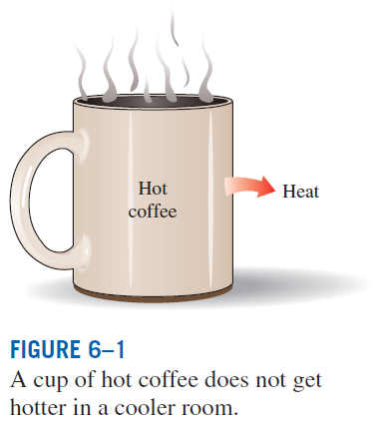
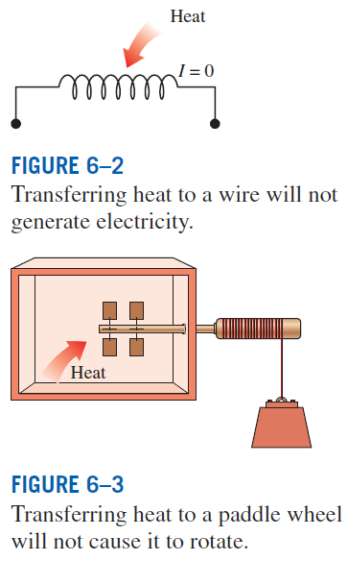
INTRODUCTION TO THE SECOND LAW
These processes cannot occur even though they are not in violation of the first law.

Slide 4
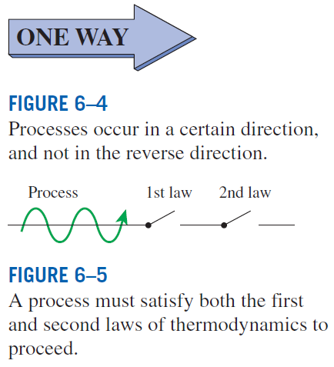
MAJOR USES OF THE SECOND LAW
The second law may be used to identify the direction of processes.
The second law also asserts that energy has quality as well as quantity. The first law is concerned with the quantity of energy and the transformations of energy from one form to another with no regard to its quality. The second law provides the necessary means to determine the quality as well as the degree of degradation of energy during a process.
The second law of thermodynamics is also used in determining the theoretical limits for the performance of commonly used engineering systems, such as heat engines and refrigerators, as well as predicting the degree of completion of chemical reactions.

Slide 5
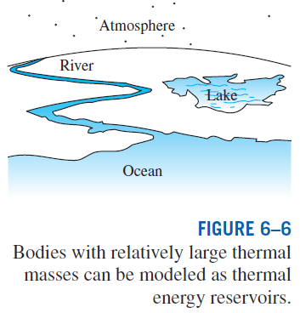
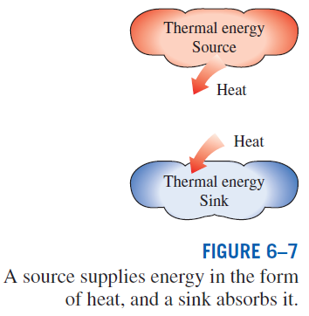
THERMAL ENERGY RESERVOIRS
A hypothetical body with a relatively large thermal energy capacity (mass x specific heat) that can supply or absorb finite amounts of heat without undergoing any change in temperature is called a thermal energy reservoir, or just a reservoir.
In practice, large bodies of water such as oceans, lakes, and rivers as well as the atmospheric air can be modeled accurately as thermal energy reservoirs because of their large thermal energy storage capabilities or thermal masses.

Slide 6
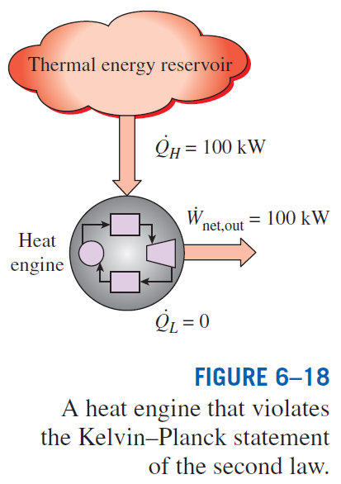
The Second Law of Thermodynamics:
Kelvin-Planck Statement
It is impossible for any device that operates on a cycle to receive heat from a single reservoir and produce a net amount of work.
No heat engine can have a thermal efficiency of 100 percent, or as for a power plant to operate, the working fluid must exchange heat with the environment as well as the furnace.
The impossibility of having a 100% efficient heat engine is not due to friction or other dissipative effects. It is a limitation that applies to both the idealized and the actual heat engines.

Slide 7
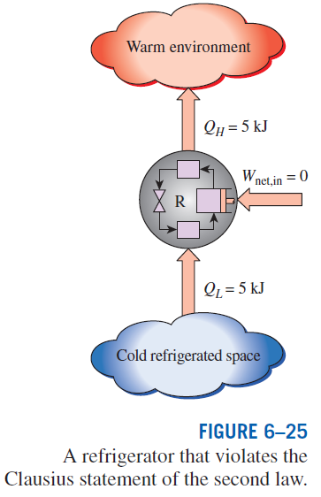
The Second Law of Thermodynamics: Clausius Statement
It is impossible to construct a device that operates in a cycle and produces no effect other than the transfer of heat from a lower-temperature body to a higher-temperature body.
It states that a refrigerator cannot operate unless its compressor is driven by an external power source, such as an electric motor.
This way, the net effect on the surroundings involves the consumption of some energy in the form of work, in addition to the transfer of heat from a colder body to a warmer one.
To date, no experiment has been conducted that contradicts the second law, and this should be taken as sufficient proof of its validity.

Slide 8
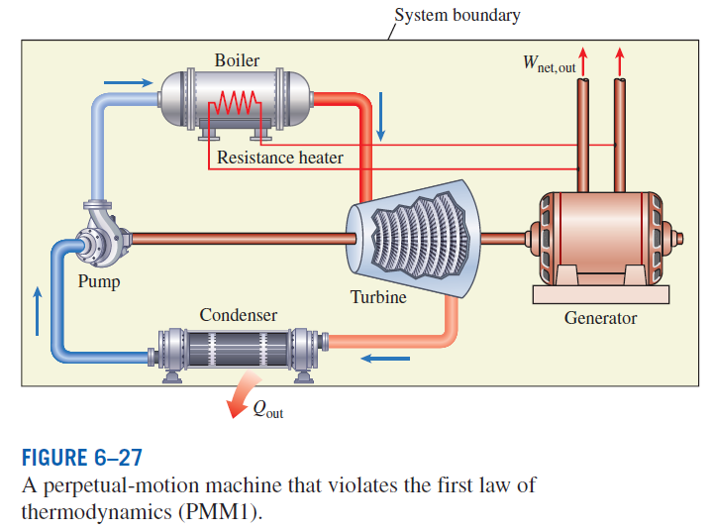
PERPETUAL-MOTION MACHINES
Perpetual-motion machine: Any device that violates the first or the second law.
A device that violates the first law (by creating energy) is called a PMM1.
A device that violates the second law is called a PMM2.

Slide 9
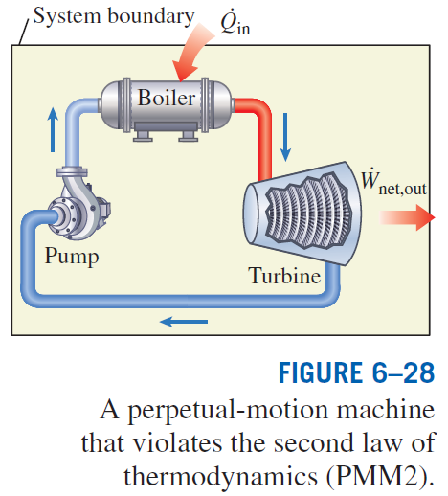
Despite numerous attempts, no perpetual-motion machine is known to have worked.
If something sounds too good to be true, it probably is.

Slide 10
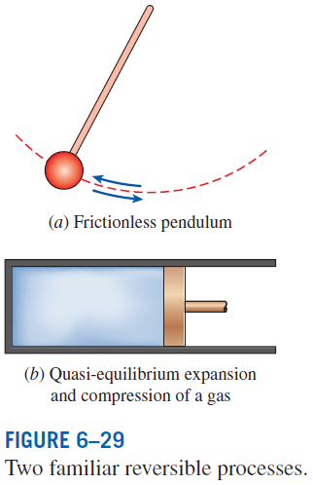
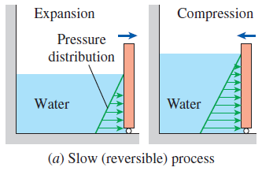
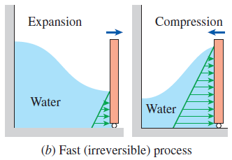
REVERSIBLE AND IRREVERSIBLE PROCESSES
Reversible Process: A process that can be reversed without leaving any trace on the surroundings.
Irreversible Process: A process that is not reversible.
All the processes occurring in nature are irreversible.
Why are we interested in reversible processes?
(1) they are easy to analyze and (2) they serve as idealized models (theoretical limits) to which actual processes can be compared.
Some processes are more irreversible than others.
We try to approximate reversible processes. Why?
Reversible processes deliver the most and consume the least work.

Slide 11
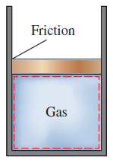
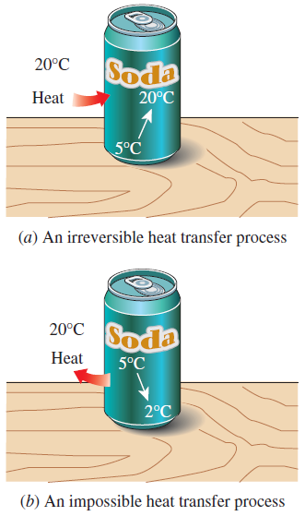
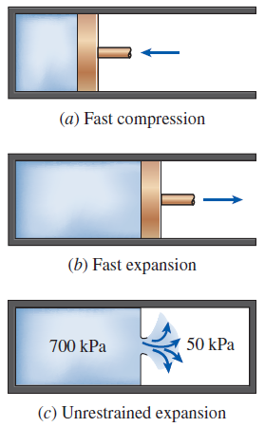
The factors that cause a process to be irreversible are called irreversibilities.
They include friction, unrestrained expansion, mixing of two fluids, heat transfer across a finite temperature difference, electric resistance, inelastic deformation of solids, and chemical reactions.
The presence of any of these effects renders a process irreversible.
Friction renders a process irreversible.
Irreversibilities
(a) Heat transfer through a temperature difference is irreversible, and (b) the reverse process is impossible.
Irreversible compression and expansion processes.

Slide 12
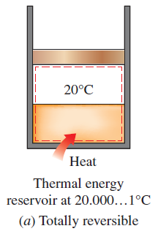
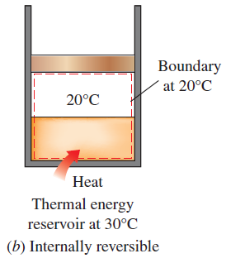
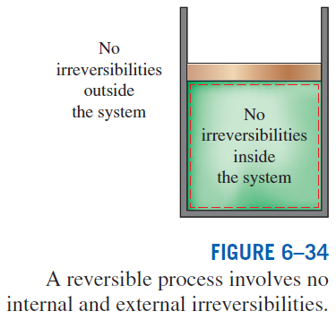

Internally and Externally Reversible Processes
Internally reversible process: If no irreversibilities occur within the boundaries of the system during the process.
Externally reversible: If no irreversibilities occur outside the system boundaries.
Totally reversible process: It involves no irreversibilities within the system or its surroundings.
A totally reversible process involves no heat transfer through a finite temperature difference, no nonquasi-equilibrium changes, and no friction or other dissipative effects.

Slide 13
Review
Example 1
A coal burning steam power plant produces a net power of 300 MW with an overall thermal efficiency of 32%. The actual air-fuel ratio in the furnace is calculated to be 12 (kg air) : 1 (kg fuel). The heating value of the coal is 28,000 kJ/kg. Determine the amount of coal consumed during a 24 hour period and the rate of air flowing through the furnace.

Slide 14
Review
Example 2
R-134a enters the condenser of a residential heat pump at 800 kPa and 35°C at a rate of 0.018 kg/s and leaves at 800 kPa as a saturated liquid. If the compressor consumes 1.2 kW of power, determine the COP of the heat pump and the rate of heat absorption from the outside air.

Slide 15
Review
Example 3
Consider a building whose annual air-conditioning load is estimated to be 40,000 kWhr in an area where the unit cost of electricity is $0.10/kWhr. Two air conditioners are considered for the building. Air conditioner A has a seasonal average COP of 2.3 and costs $5,500 to install. Air conditioner B has a seasonal average COP of 3.6 and costs $7,000 to install. In how many years, will the total cost to install and operate be equal between the two conditioners?

Slide 16
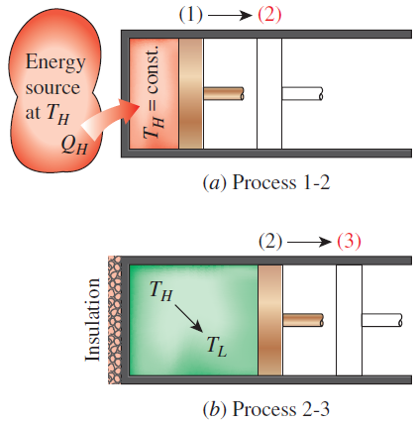
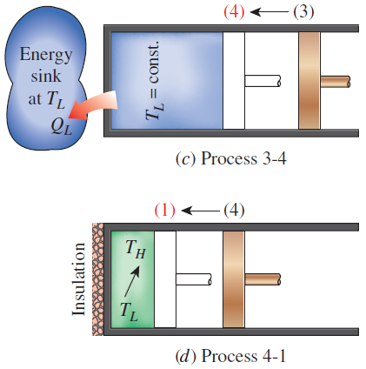
THE CARNOT CYCLE
Execution of the Carnot cycle in a closed system.
Reversible Isothermal Expansion (process 1-2, T_{H} = constant)
Reversible Adiabatic Expansion (process 2-3, temperature drops from T_{H} to T_{L})
Reversible Isothermal Compression (process 3-4, T_{L} = constant)
Reversible Adiabatic Compression (process 4-1, temperature rises from T_{L} to T_{H})

Slide 17
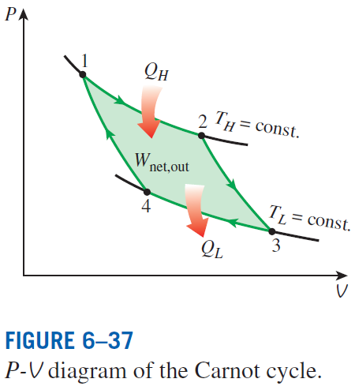
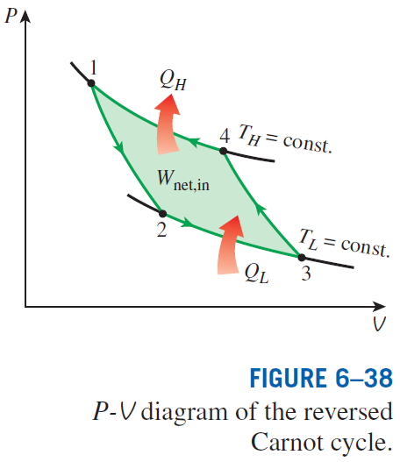
The Reversed Carnot Cycle
The Carnot heat-engine cycle is a totally reversible cycle.
Therefore, all the processes that comprise it can be reversed, in which case it becomes the Carnot refrigeration cycle.

Slide 18
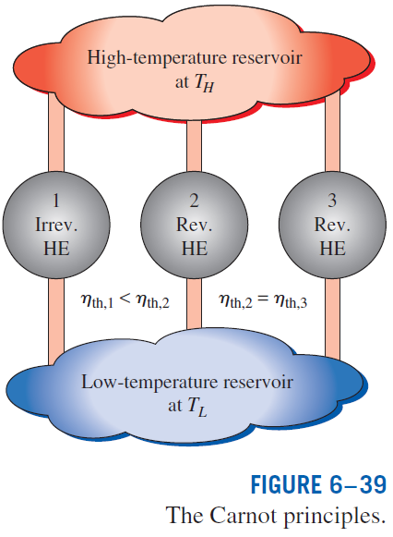
THE CARNOT PRINCIPLES
The efficiency of an irreversible heat engine is always less than the efficiency of a reversible one operating between the same two reservoirs.
The efficiencies of all reversible heat engines operating between the same two reservoirs are the same.

Slide 19
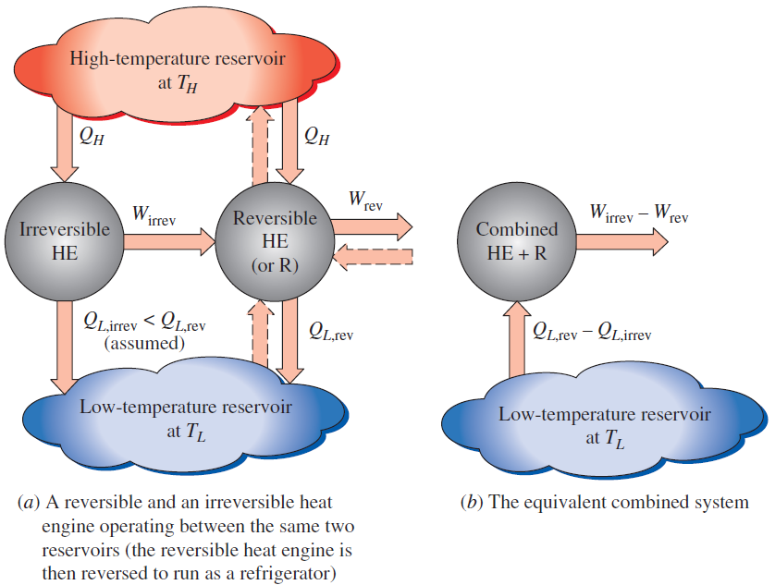


Slide 20
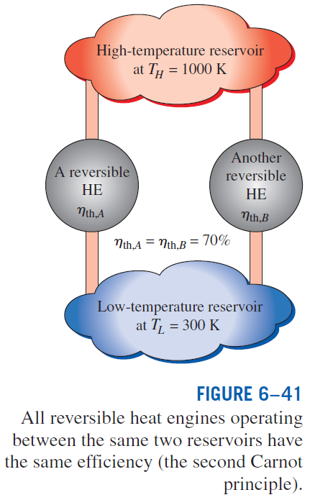

Slide 21
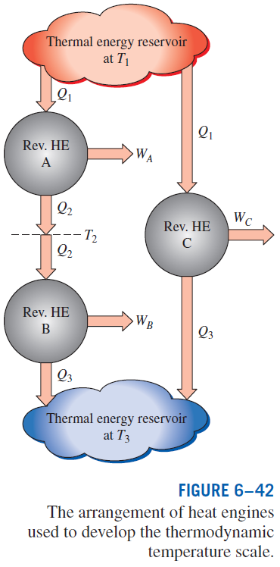
THE THERMODYNAMIC TEMPERATURE SCALE
A temperature scale that is independent of the properties of the substances that are used to measure temperature is called a thermodynamic temperature scale.
Such a temperature scale offers great conveniences in thermodynamic calculations.

Slide 22
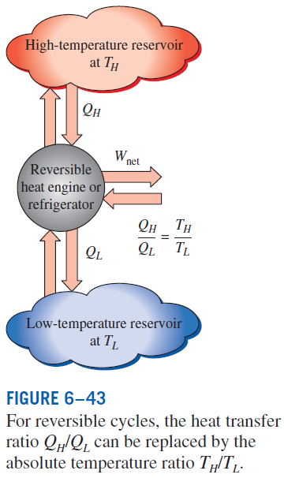
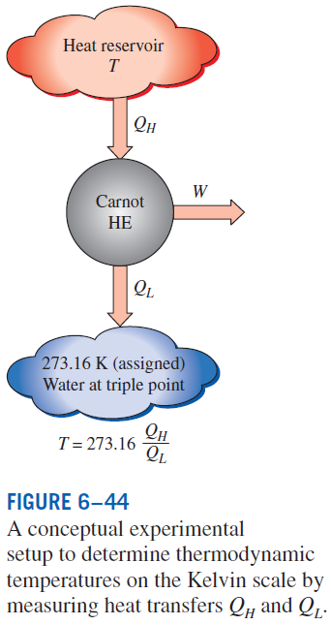


This temperature scale is called the Kelvin scale, and the temperatures on this scale are called absolute temperatures.

Slide 23
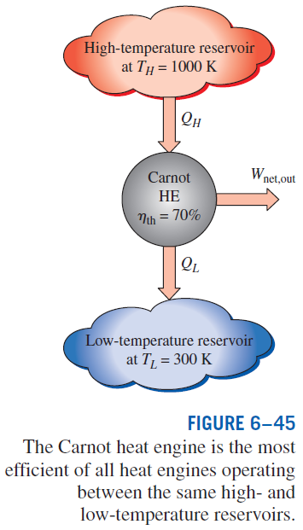


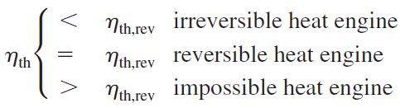
THE CARNOT HEAT ENGINE
Any heat engine
Carnot heat engine

Slide 24
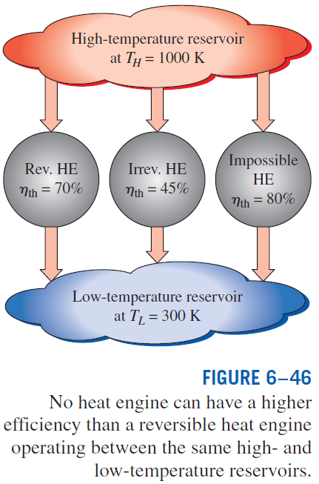

Slide 25
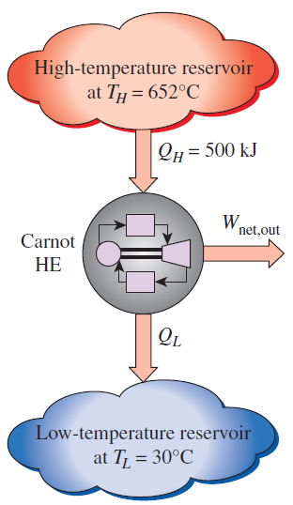
Analysis of a Carnot Heat Engine
Example 4
A Carnot heat engine receives 500 kJ of heat per cycle from a high-temperature source at 652ºC and rejects heat to a low temperature sink at 30ºC. Determine the thermal efficiency of this Carnot engine and the amount of heat rejected to the sink per cycle.

Slide 26
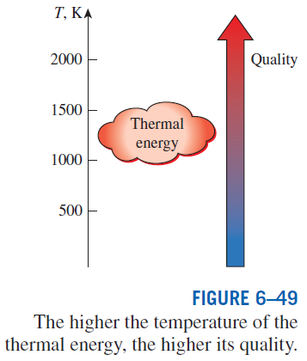
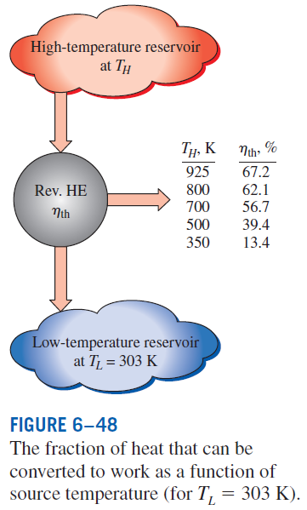
The Quality of Energy
Can we use °C unit for temperature here?
How do you increase the thermal efficiency of a Carnot heat engine?
How about for actual heat engines?

Slide 27
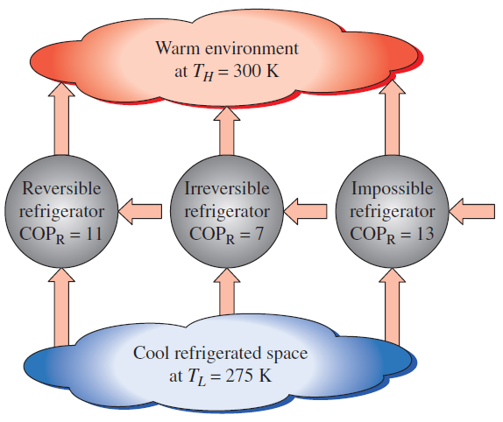
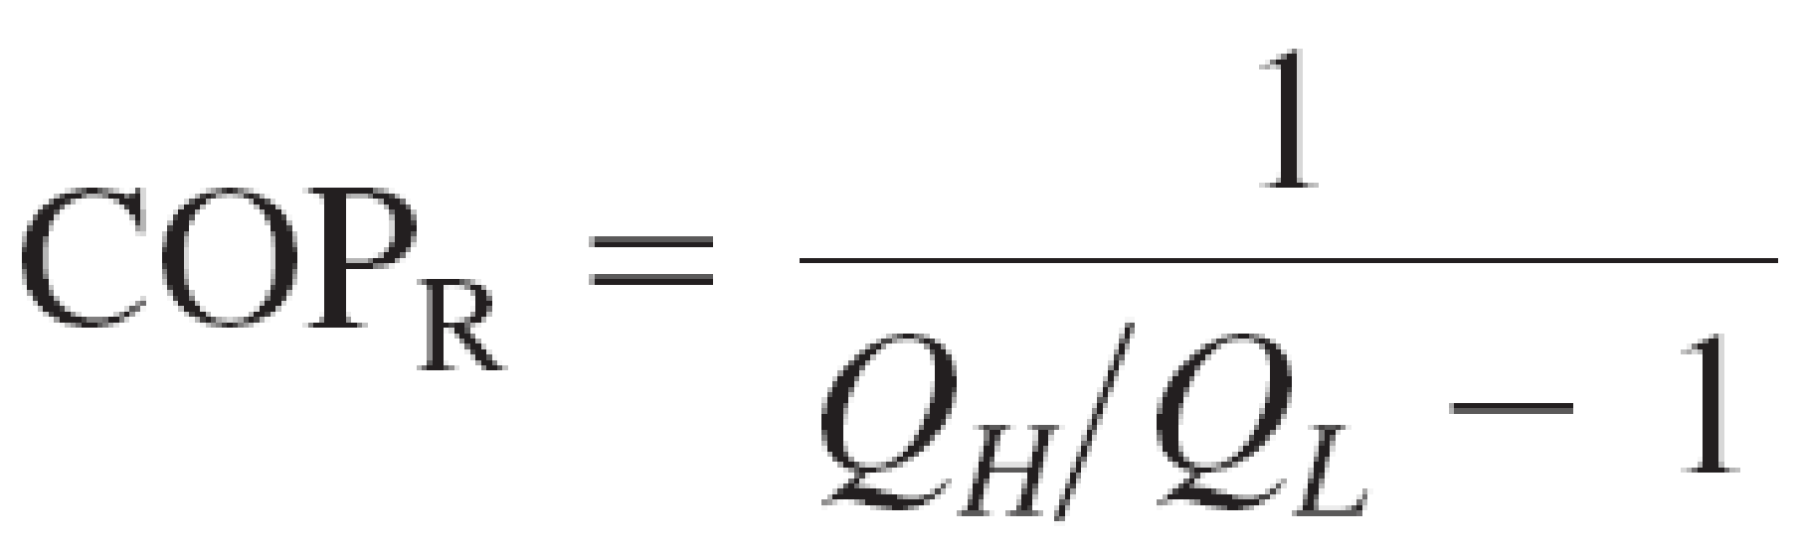



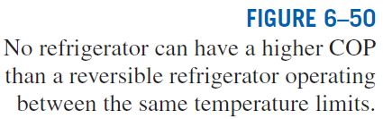
THE CARNOT REFRIGERATOR AND HEAT PUMP
Any refrigerator or heat pump
Carnot refrigerator or heat pump
How do you increase the COP of a Carnot refrigerator or heat pump? How about for actual ones?

Slide 28
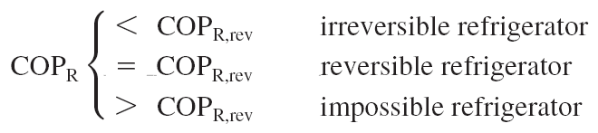
The COP of a reversible refrigerator or heat pump is the maximum theoretical value for the specified temperature limits.
Actual refrigerators or heat pumps may approach these values as their designs are improved, but they can never reach them.
The COPs of both the refrigerators and the heat pumps decrease as T_{L} decreases.
That is, it requires more work to absorb heat from lower-temperature media.

Slide 29
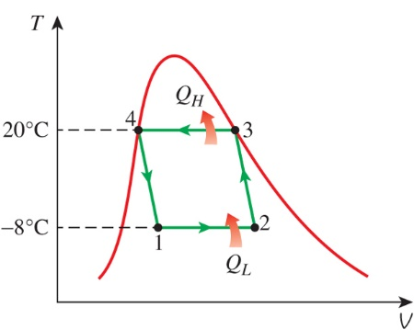
A Carnot Refrigerator Operating in the Saturation Dome
Example 5
A Carnot refrigeration cycle is executed in a closed system in the saturated liquid-vapor mixture region using 0.8 kg of R-134a as the working fluid. The maximum and minimum temperatures in the cycle are 20 and -8ºC, respectively. It is known that the R-134a is a saturated liquid at the end of the heat rejection process, and the net work input to the cycle is 15 kJ. Determine the mass that vaporizes during the heat addition process and the pressure at the end of the heat rejection process.

Slide 30
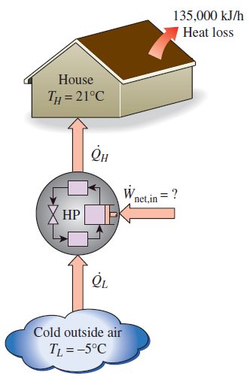
Heating a House by a Carnot Heat Pump
Example 6
A heat pump is to be used to heat a house during the winter. The house is to be maintained at 21ºC. The house is estimated to lose heat at a rate of 135,000 kJ/hr when the outside temperature drops to -5ºC. Determine the minimum power required to drive this heat pump.

Slide 31
Proving the Validity of a Refrigerator
Example 7
During an experiment conducted in a room at 25°C, a lab assistant measures that a refrigerator that draws 2 kW of power has removed 30,000 kJ of heat over a 20 minute period from a refrigerated space maintained at -30°C. Determine the COP of the refrigerator and whether it is possible.

Slide 32
Summary
Introduction to the second law
Thermal energy reservoirs
Perpetual motion machines
Reversible and irreversible processes
Irreversibilities, Internally and externally reversible processes
The Carnot cycle
The reversed Carnot cycle
The Carnot principles
The thermodynamic temperature scale
The Carnot heat engine
The quality of energy
The Carnot refrigerator and heat pump

